Slide 1


CENSORING AND TRUNCATION

Slide 2
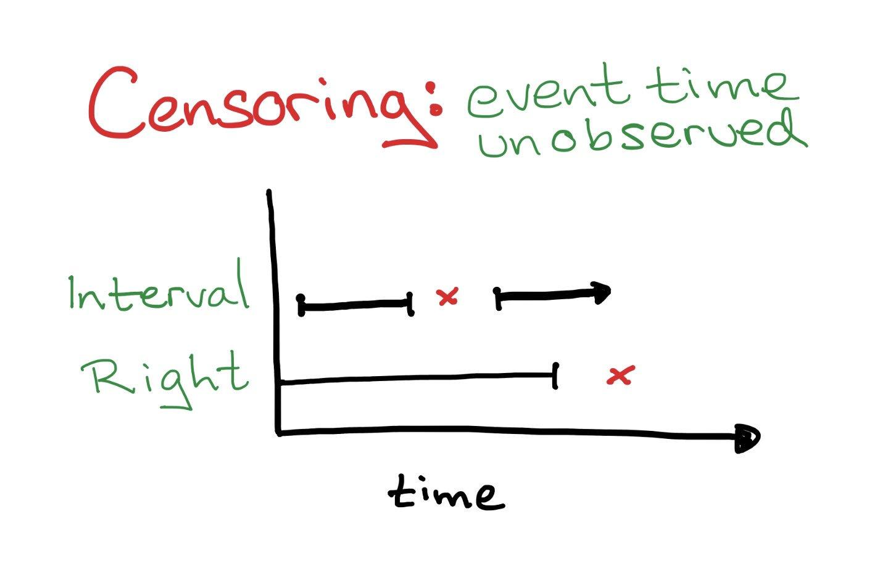
CENSORING BACKGROUND
In survival analysis we are interested in
measuring “time to event” from a
relevant exposure.
Censoring occurs when we don’t know
the exact time-to-event for an included
observation.

Slide 3
In survival analysis, there are two types of observations:
Event occurred and it was able to get measured when it occurred.
The event didn't occur during the observed time, and only total number of days in which it didn’t occur is known (censored).

Slide 4
Types Of Censoring
Right Censoring
Left Censoring
Interval Censoring

Slide 5
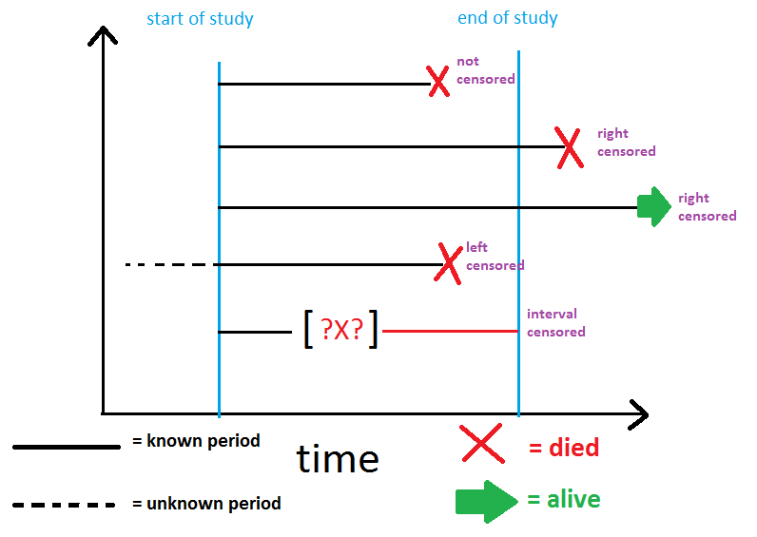
RIGHT CENSORING
We know that time-to-event is Greater than some value.
t > X

Slide 6
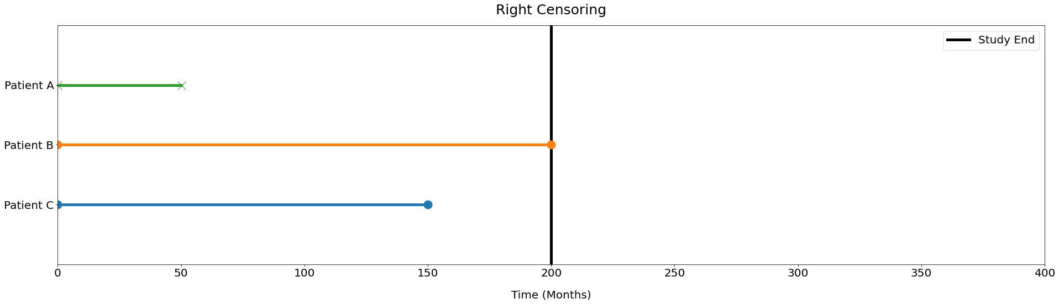
EXAMPLES
Study: Estimating survival time after diagnosis of Leukemia
Patient A: Experiences event before the study ends
Patient B: Survives passed the end of the study
Patient C: Withdraws from the study.
Consideration:
Patients still alive at end of the study
Patients lost to follow up

Slide 7
LEFT CENSORING
We know that time-to-event is less than some value.
t < X
For obvious reasons if the event is death, the data can’t be left-censored.
A good example is virus testing.

Slide 8

EXAMPLES
Study: Survey some women at 250 day mark , when they had their baby.
Consideration:
Some women enrolled in the study who already had their babies before 250 days but we don’t know exactly when.

Slide 9
INTERVAL CENSORING
We know that time-to-event is BETWEEN two values.
X1 < t < X2

Slide 10

EXAMPLES
Study: Covid 19 test from december 2019
Consideration:
if we have the situation where we’ve performed testing on the indvidual at some timepoint (t1) and the individual was negative. But then at a timepoint further on (t2), the individual tested positive.

Slide 11
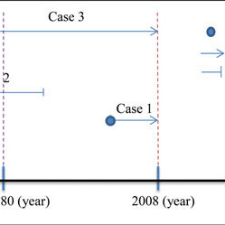
TRUNCATION
Truncation occurs when observations
are excluded by virtue of their
time-to-event.

Slide 12
Types Of Truncation
Right Truncation
Left Truncation

Slide 13
LEFT TRUNCATION
observation with short time-to-event are excluded

Slide 14
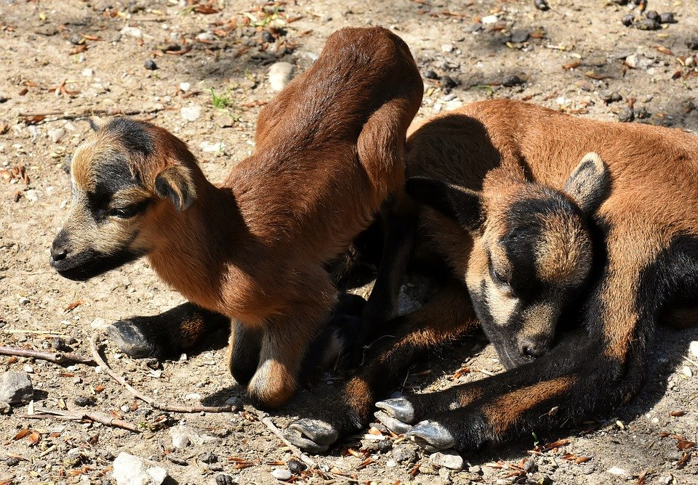
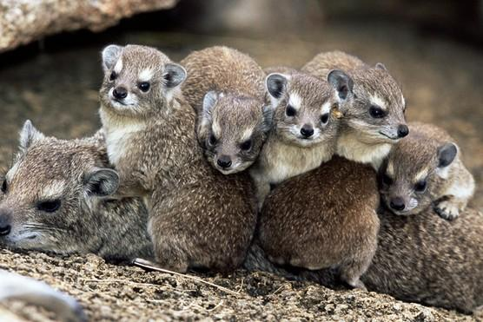
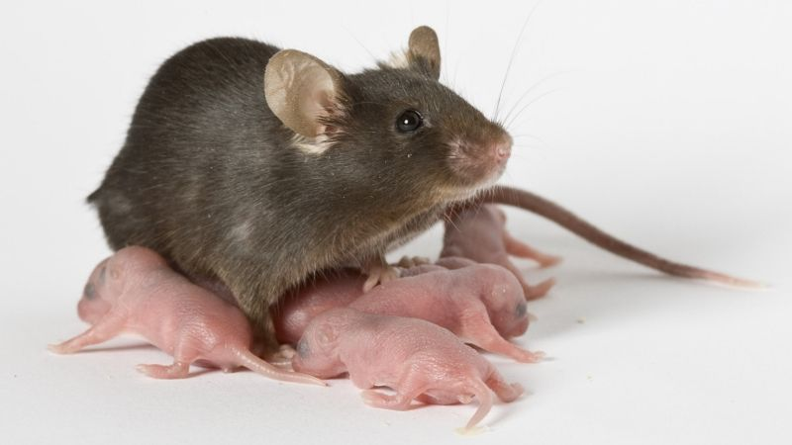
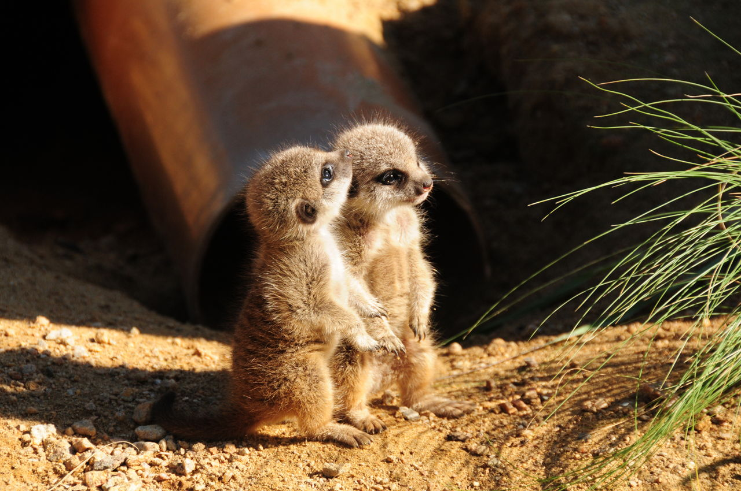
EXAMPLES
Study: Estimating survival times of animal neonates.
Consideration:
neonates with very short survival will likely be excluded from the samples.

Slide 15
RIGHT TRUNCATION
observation with LONG time-to-event are excluded

Slide 16
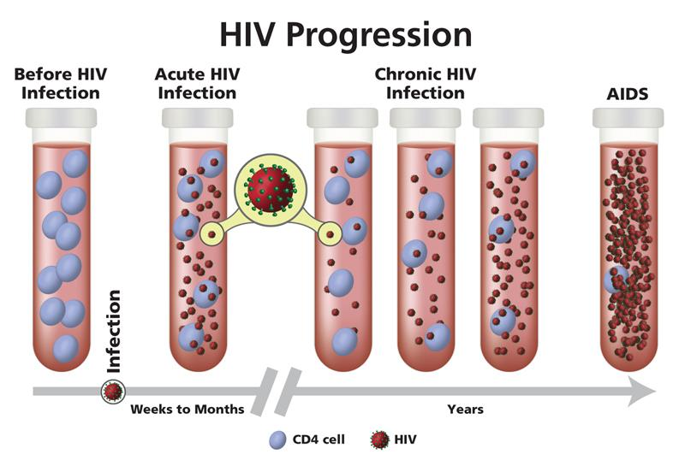
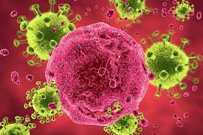
EXAMPLES
Study: Estimating time to development of AIDS from HIV virus.
Consideration:
entry into study occurs only after development of AIDS.

Slide 17
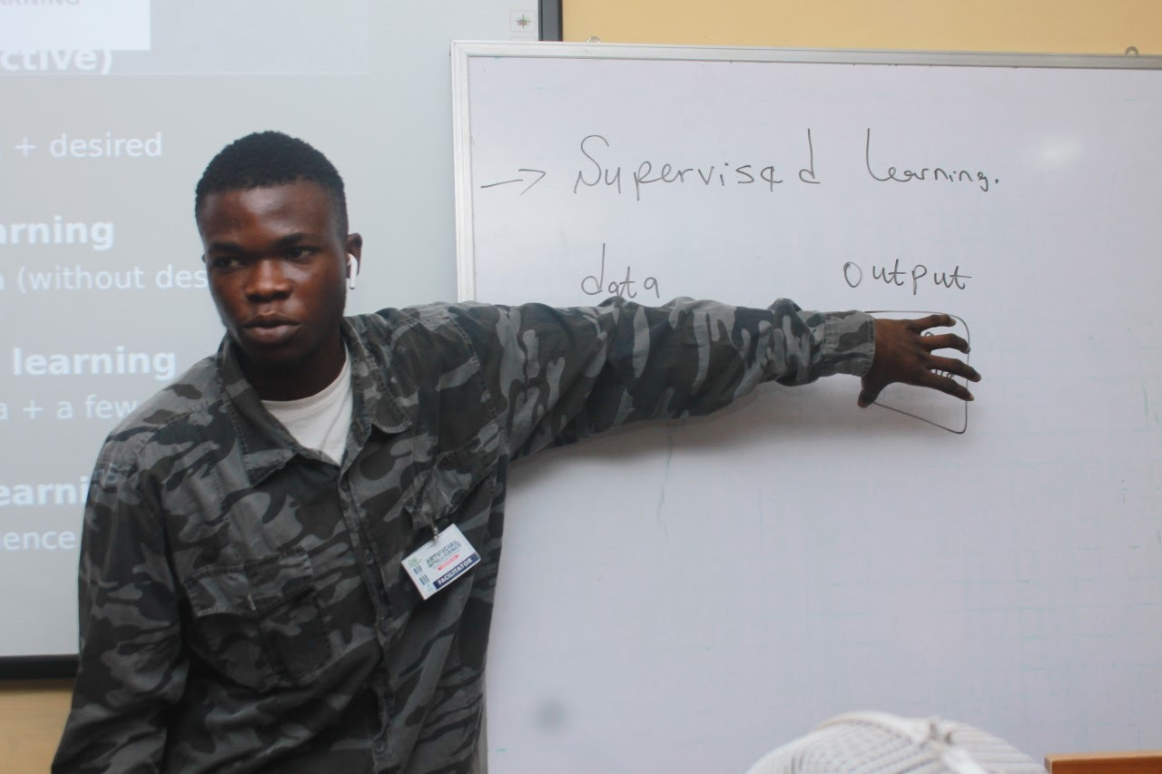



OLALEYE ENIOLA
Data Scientist
@galileo.eni
https://www.linkedin.com/in/eniola-olaleye-361b39160/
eniolaolaleye426@gmail.com

Slide 18
THANK YOU

